Slide 1
DataChatter – Connecting Diverse Personal Databases to Chatbot AI for Natural Language Interaction

Slide 2
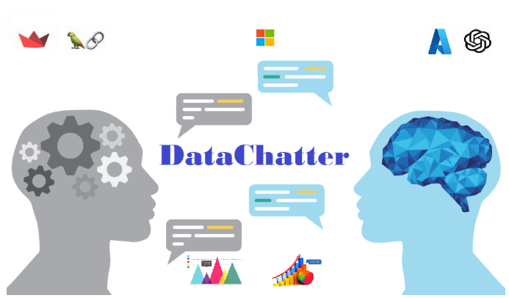
Opportunity
Provide users an intuitive capability to get needed information and insights from their data sources using natural language
Notes:
Problem or Opportunity
Traditional methods of querying databases often require users to possess specialized knowledge and skills in writing SQL queries or other data-specific languages. For non-technical users or those unfamiliar with database systems, this can be a significant barrier to accessing and utilizing valuable data.
DataChatter aims to solve this problem by providing a user-friendly interface that allows anyone, regardless of technical background, to interact with their personal databases using natural language. The application bridges the gap between data and users by enabling them to communicate their queries in plain English, which are then processed and interpreted by the language model. This way, users can effortlessly access and retrieve information from their databases without the need for complex queries or technical expertise.
By enabling easy communication with personal databases through natural language, DataChatter empowers users to make data-driven decisions, gain insights, and conduct data analysis efficiently. The project seeks to democratize access to data and make it accessible to a broader audience, promoting data literacy and understanding across various domains and industries.

Slide 3
Use Cases
A finance analyst wants to determine costs and revenue for certain categories over a time period stored in a comma separated value (csv) file(s) to optimize spends
A medical professional would like to determine root cause, symptoms and key patient data from huge pdf files to perform health analysis
A legal team analyst would like to identify key case details, investigation and resolution from previous cases to come with an effective synopsis
A creative media professional would want to derive actions, figures, sentiments and other insights from an internet video on Youtube/Vimeo
A data analyst can derive sales and marketing information from Azure SQL Database without writing technical queries/SQL

Slide 4
Value Proposition
Democratize access to data and make it accessible to a broader audience, promoting data literacy and understanding across various domains and industries.
Complements and extends co-pilot solution for Office 365

Slide 5
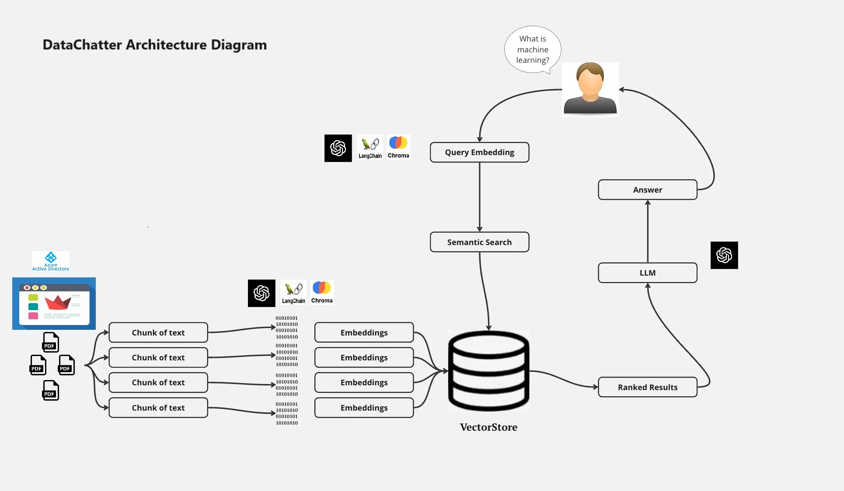
Technologies & Architecture
AAD for security
Streamlit for UI
OpenAI GPT for LLM
Langchain for LLM Framework
Chroma for Vector Storage
Pandasai for handling csv

Slide 6
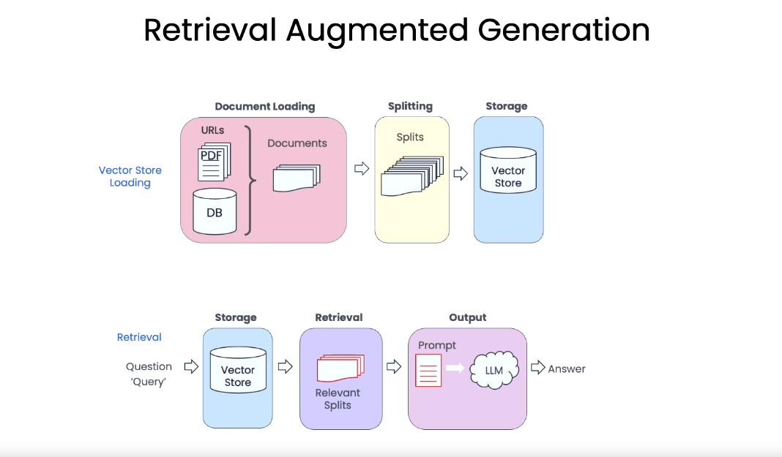

Slide 7
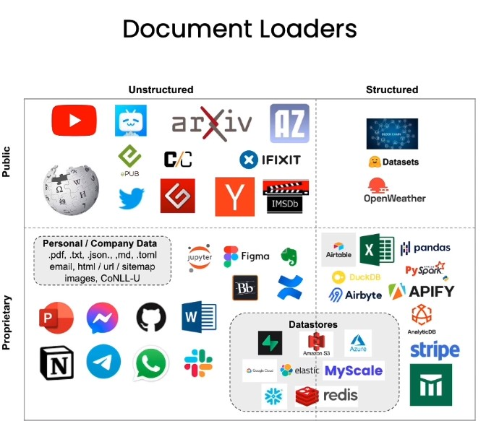
Future Proposed Supporting Document Types

Slide 8
Data Chatter
One sentence to describe concisely what you built/made​
Provide users an intuitive capability to extract information and insights from their data sources using natural language

Slide 9
What’s your hack project story?
Where did the idea come from?
Why do you care about this idea/area?
How does this relate to your day jobs, if at all?
Notes:
Note: Don’t spend too much time on the “set-up” or problem statement. Viewers usually pick that up quickly, and they want to get to hearing about your project/solution.

Slide 10
Primary customer
Who is this project for?

Slide 11
How does it work?
Show your project and explain how it works
Identify the technologies you used
Describe the work you did during the Hackathon

Slide 12
Value for the Customer
Why is this solution different and compelling for the customer?

Slide 13
Value for Microsoft
What business value does your project provide to Microsoft? e.g., attract new users, make current users happier, increase revenue, do some good in the world, increase usage, retain customers, etc.

Slide 14
Tips
Be concise.
Make your presentation as simple as possible, but no simpler.

